Slide 1
Office 365 Development
July 2014

Slide 2
Moving Full Trust Code to the Cloud Using Repeatable Patterns and Best Practices
Jeremy Thake @jthake
Technical Product Manager

Slide 3
Agenda
Why Apps
App Basics
Top Customization Scenarios

Slide 4
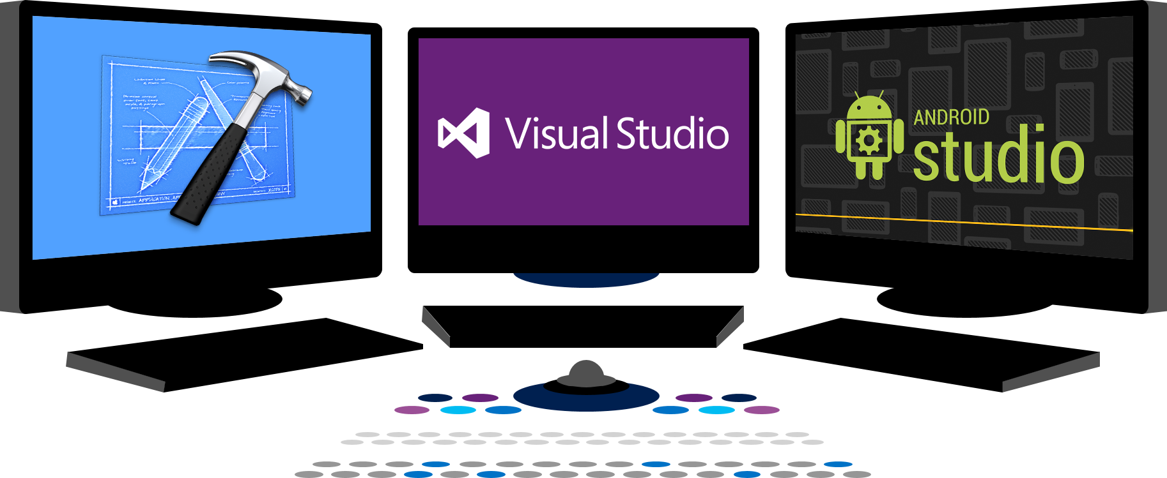














Vision
EXTEND OFFICE EVERYWHERE
CONNECT TO OFFICE 365 SERVICES
BUILD USING AN OPEN PLATFORM
Delve
z
Users and groups
Files
Mail
Calendar
My Apps
Video Portal
Contacts
Office Graph
Presentations
Documents
Spreadsheets
Lync
OneNote
Yammer

Slide 5
Why Apps ?

Slide 6
The App Proposition…
Apps are decoupled from SharePoint
Apps run in the cloud or on the client…NOT on the same w3wp.exe as SharePoint
Apps can be hosted pm any web platform from virtually anywhere in the world
Reduces the friction between SharePoint Developers and IT Pros
Lightweight developer story
Traditional SharePoint assemblies are not remotable… developers required dedicated farms
App developers only need a developer site collection
Customizations based on web standard
Apps leverage the best of HTML5/CSS3/JavaScript
Leverage any server-side web technology that can render HTML…MVC, PHP, Java
Apps are Discoverable
Corporate App Catalogs for private customizations and the Office Marketplace for public apps
Notes:
3min
STEVE

Slide 7
App Basics

Slide 8
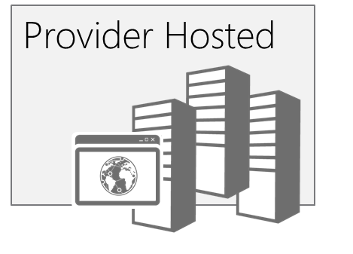
App Hosting
SharePoint
Oauth + REST or client object models
Existing sites and services
The app and all resources are hosted by the provider in any environment suitable for the app.
App web (optional)
SharePoint
hosted
Existing sites and services
The app and all resources are hosted in your organization’s SharePoint farm. Relies on client side technologies. Your IT organization supports the app.
App web
Notes:
Richard

Slide 9
SharePoint 2013 Remote API
_api is new alias for _vti_bin/client.svc
Server
Execute Query
Client
OData
JavaScript Library
Silverlight Library
.Net CLR Library
Custom Client Code
Notes:
Steve

Slide 10
Surfacing Apps (User Experience)
 | Shape | Description | Example
 | Immersive Full Page App | App that implements a new scenario for customers ALL apps have a full-page experience | Resource Tracking, Budgeting
 | App Part | Provides new parts you can add to your sites | Weather, Team Mascot, News
 | Extension App | Add new actions for documents and items | Display Document Visualization, Print to Print Service Vendor
 | SharePoint Dialog | Usually used in conjunction with Custom Action, but could be scripted in page or in OOTB controls | New site, Custom Upload, Get a Tiny URL
Notes:
Richard

Slide 11
Common Customization Requests

Slide 12
Common Customization Requests
User Experiences
SharePoint Timer Jobs
SharePoint Delegate Controls
Site Templates and Provisioning
OneDrive Governance and Branding
Notes:
.5min
STEVE

Slide 13

Make look cool
Developer Patterns & Practices
Transform your code
Providing App Model Patterns for common SharePoint Full Trust Code and Office Add-in scenarios
60+ Visual Studio projects
Common scenarios Branding Site provisioning Remote event receivers
Large file support Taxonomy driven navigation And much more… aka.ms/OfficeDevPnP

Slide 14
User Experiences
Can provider-hosted apps feel like SharePoint?
Apps can leverage the Chrome Control to replicate the theme of a host web
The Chrome Control can display the host web icon and custom menuing
Will it feel like a world of iframes?
App parts can incorporate the styles from the host web
App parts can request to be resized by the host web by posting resize messages
What about common server-controls?
Office.Controls JavaScript now includes ListView and People Picker controls for provider-hosted apps
Office AMS includes a Taxonomy Picker for provider-hosted apps
Notes:
3min
RICHARD

Slide 15
Demo
User Experience in Provider-hosted App
Notes:
6min
RICHARD - Demo provider-hosted app with chrome control, listivew, people picker, taxonomy picker

Slide 16
Timer Jobs via Apps
Are operations supported by CSOM?
Significant CSOM updates in 2013, including User Profiles, Social, Taxonomy, and more
Determine Authentication Approach
OAuth approach will require a web experience to trust the app
Service Account with credentials (use SharePointOnlineCredentials in SharePoint Online)
Scheduling
Run from on-premises servers or in the cloud
Windows Azure Websites now support scheduled WebJobs
Notes:
4min
STEVE

Slide 17
Demo
Timer Jobs via Apps
Notes:
6min
STEVE - Demonstrate a timer job built as a console application deployed as a WebJob

Slide 18
SharePoint Delegate Controls
Allow UX customization without custom master page
AdditionalPageHead delegate control is commonly used in full-trust solutions to
inject customizations into an existing master page
Deployed through a CustomAction in a full-trust solution
JavaScript Injection with UserCustomAction
UserCustomAction programmatically added to host web via App Installed remote event
ScriptLink location will render as a script link to ALL pages in the host web
BE CAREFUL WITH SCIPT INJECTION!!!!
Notes:
2min
RICHARD

Slide 19
Demo
JavaScript Injection
Notes:
5min
RICHARD - Demonstrate the use of script injection in a UserCustomAction

Slide 20
Site Templates and Provisioning
The Power of Provisioning
Programmatically owning the site provisioning process enables you to do anything to
a site that CSOM (or external APIs) support
Apps don’t support site definitions, provisioning providers, or feature stapling, but the same result can be achieved
Look at Templates Projects in Office AMS
Leverages XML-based site configurations (similar to an ONET.xml or web template)
DeployManager.cs contains most of the provisioning logic
Use in conjunction with script injection techniques to own sub-site provisioning
Notes:
10min
STEVE

Slide 21
Demo
Site Templates and Provisioning
Notes:
18min
STEVE - Demonstrate the Office AMS xml template and deployment logic…also show site collection provisioning

Slide 22
OneDrive Governance and Branding
Why is OneDrive different from any other site?
Default experience for OneDrive is to provision on-demand for users
Users are site collection administrators of their OneDrive sites
Timer Jobs
Requires the enumeration of profiles or storing listing of OneDrive sites in a database
Dependent on job schedule to perform operations (not on-demand)
App Part placed on frequently visited site/page
Place all logic in an App Part that is placed on a frequently visited page such as an Intranet landing page of the MySite host site of SharePoint
Use CSOM’s ProfileLoader to read the user’s profile to get the PersonalSite property
Notes:
5min
RICHARD

Slide 23
Demo
OneDrive Governance and Branding
Notes:
8min
RICHARD - Demonstrate OneDrive branding IP from Office AMS

Slide 24


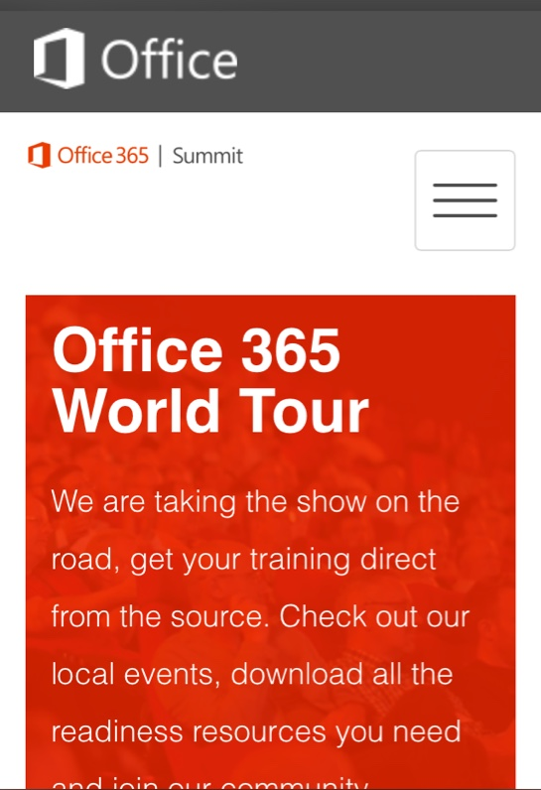
Building skills
Add screens shot from link
Microsoft Virtual Academy
dev.office.com/training
Code Samples
dev.office.com/code-samples
DX Office 365 Dev Camps
Office 365 Summit Developer Tracks
summit.office.com

Slide 25
Make look cool
Developer Patterns & Practices
Transform your code
Providing App Model Patterns for common SharePoint Full Trust Code and Office Add-in scenarios
60+ Visual Studio projects
Common scenarios Branding Site provisioning Remote event receivers
Large file support Taxonomy driven navigation And much more… aka.ms/OfficeDevPnP

Slide 26
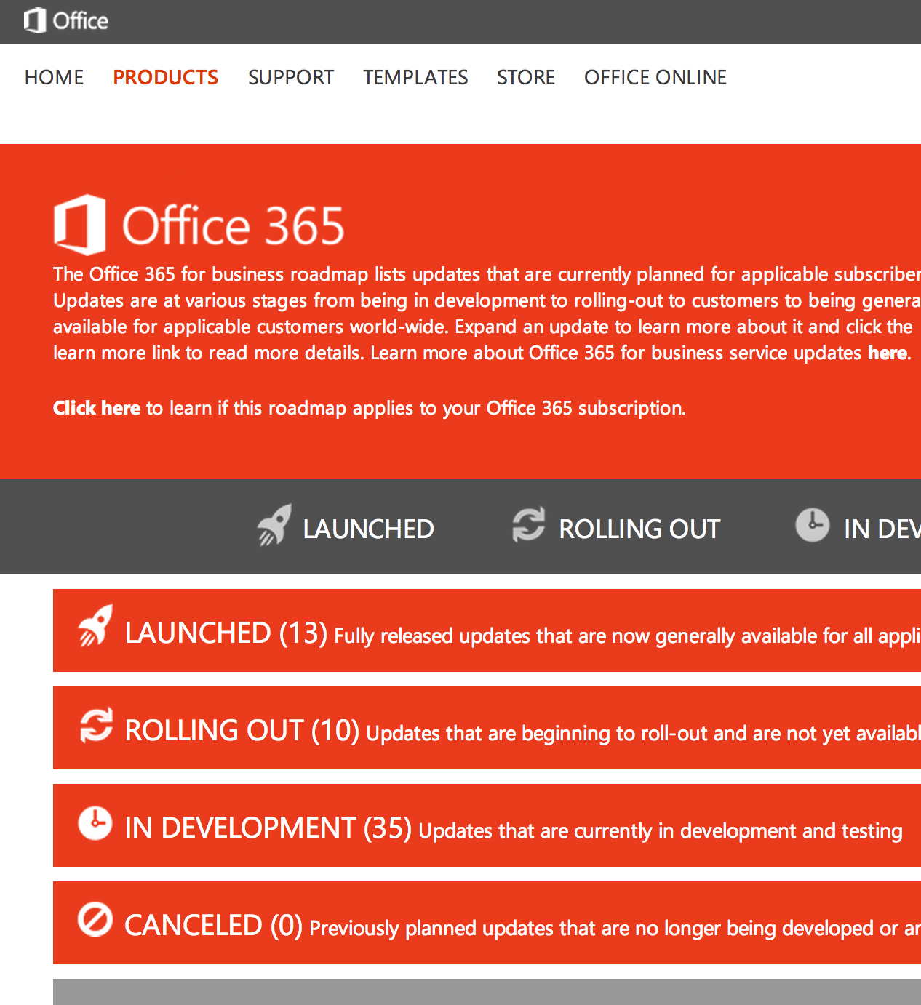
Roadmap
Monthly updates
Associated blog posts
www.office.com/roadmap

Slide 27
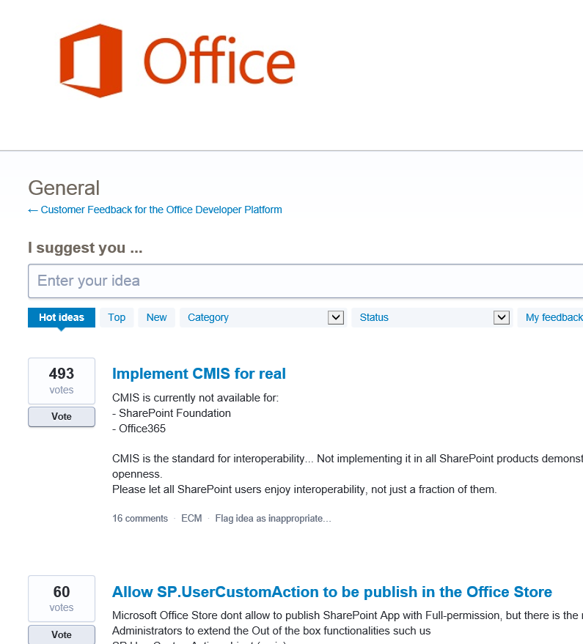

Customer feedback
Yammer Office 365 Technical Network
Stackoverflow
UserVoice Developer focused Bi-weekly triage Link to roadmap to show actions
http://aka.ms/OfficeDevFeedback

